Slide 1
400D saws team results presentation
Presented by Jordan hsu
Hub results update

Slide 2
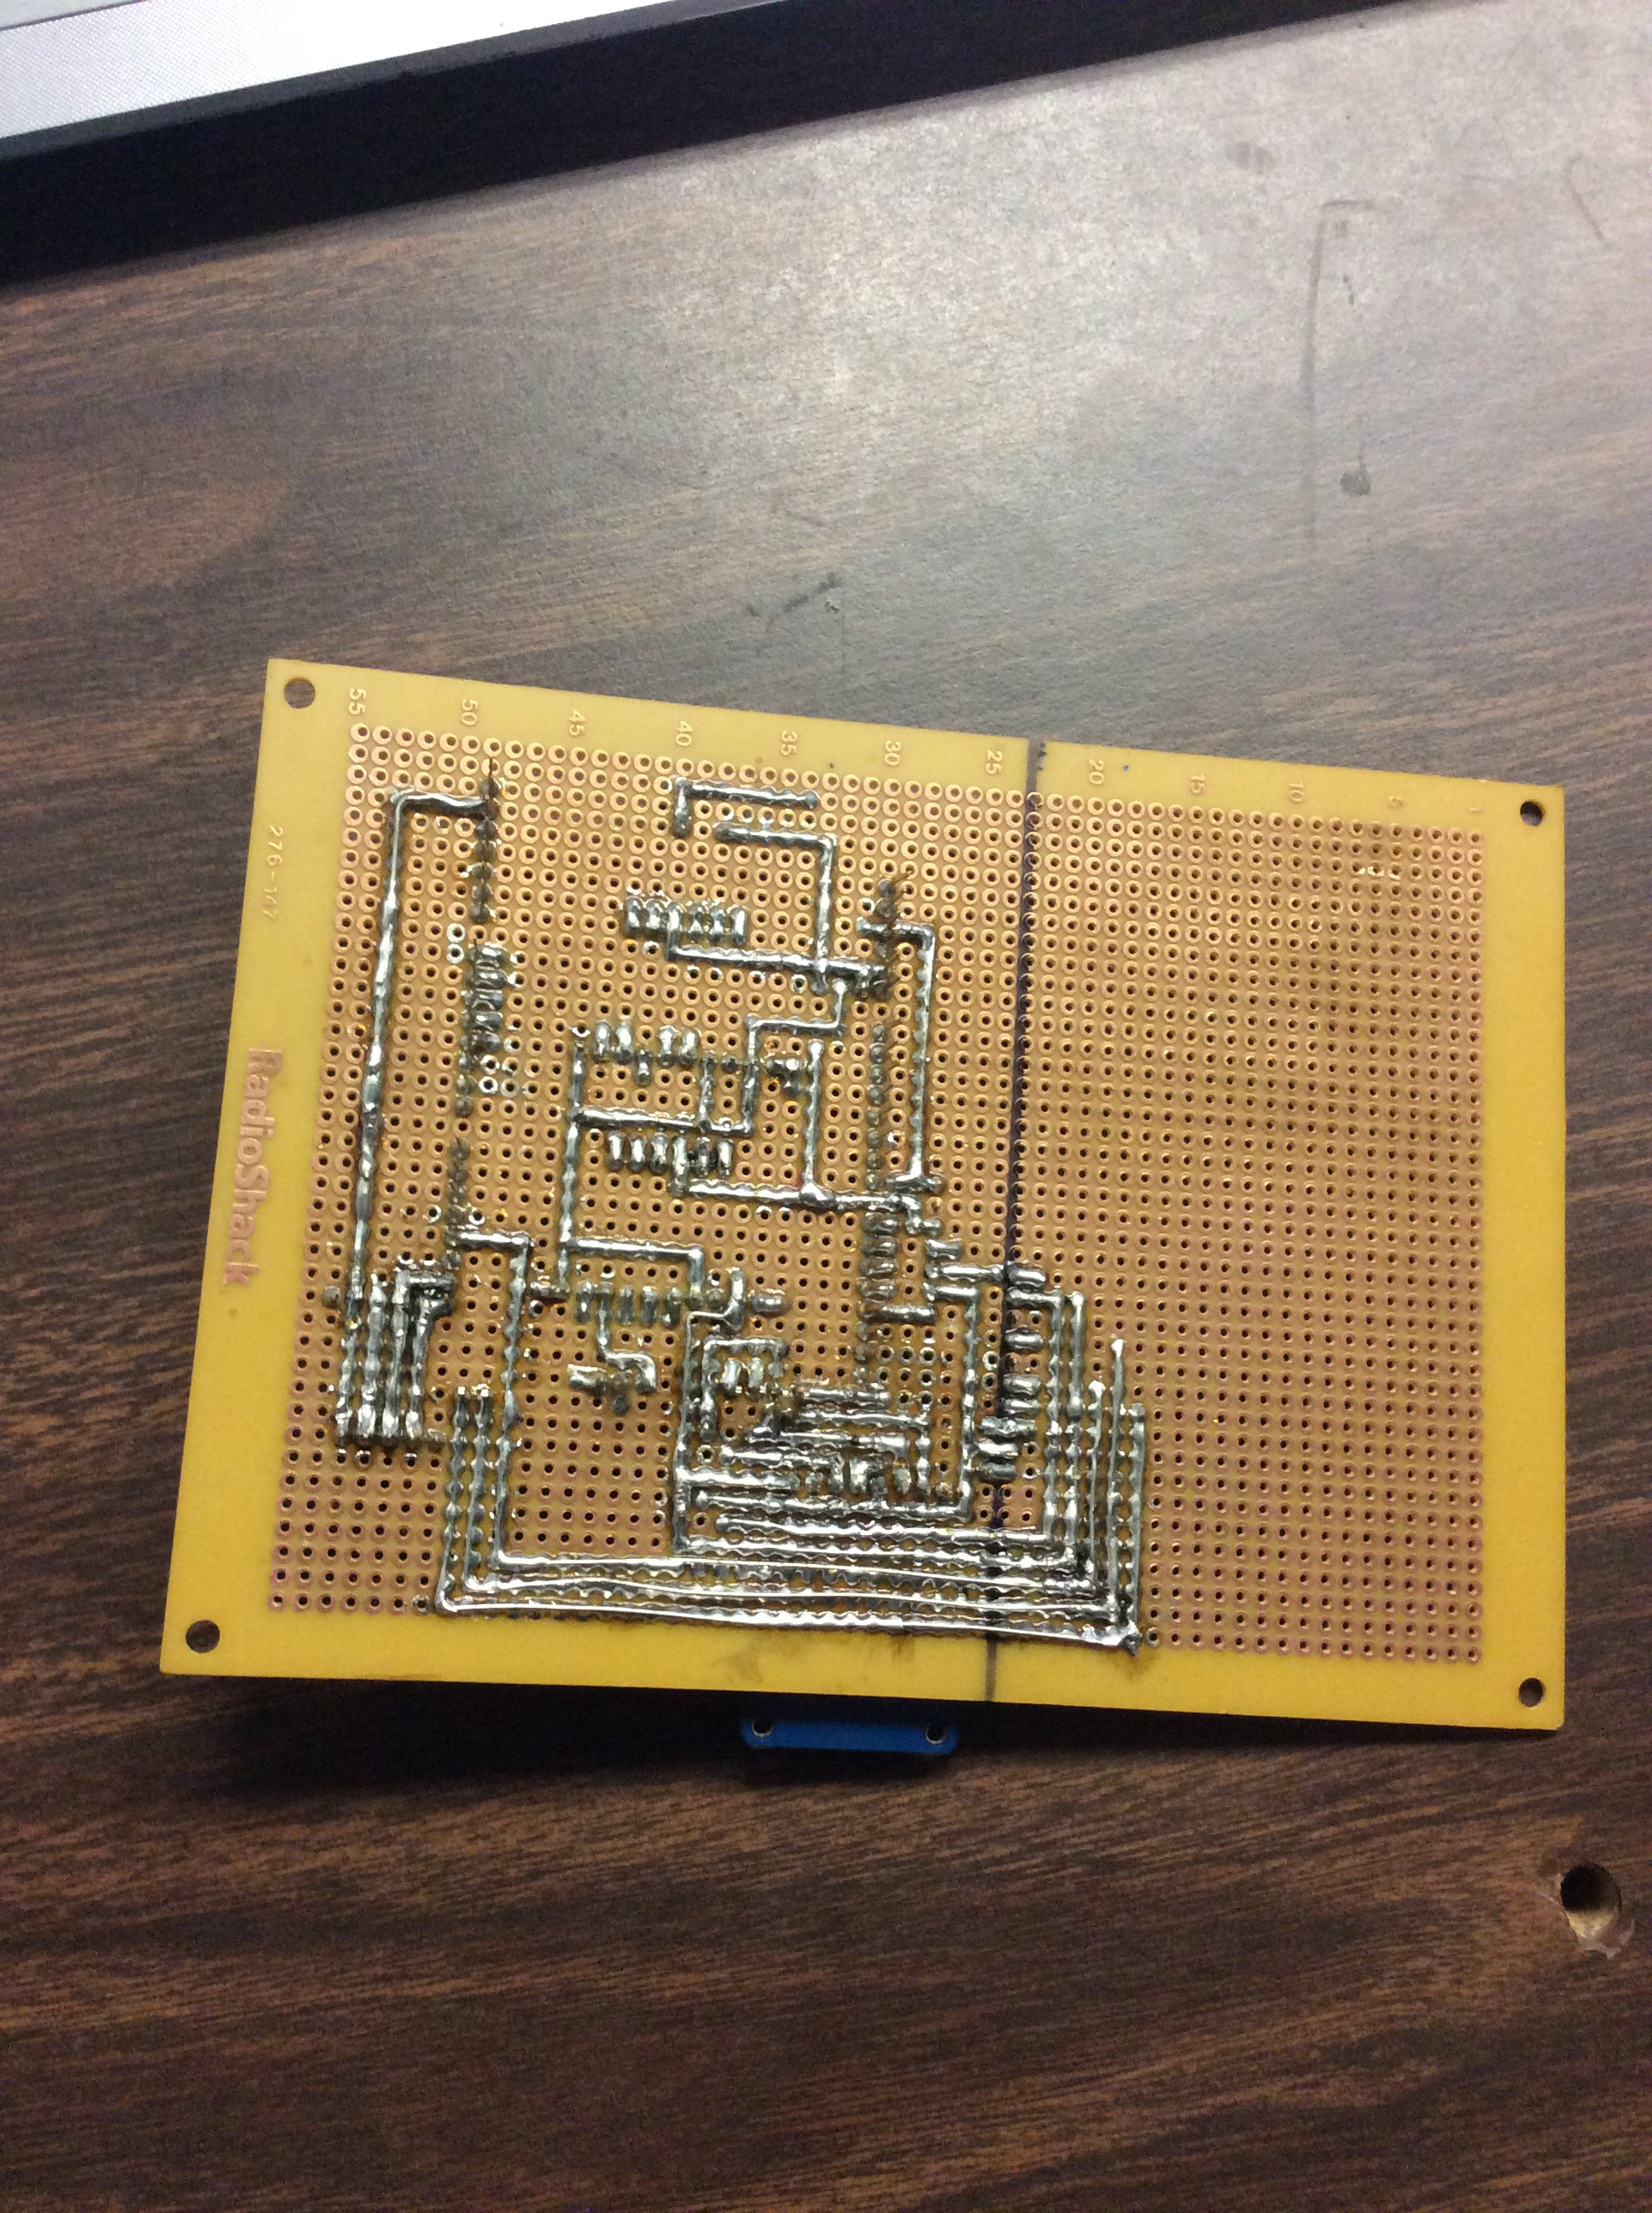
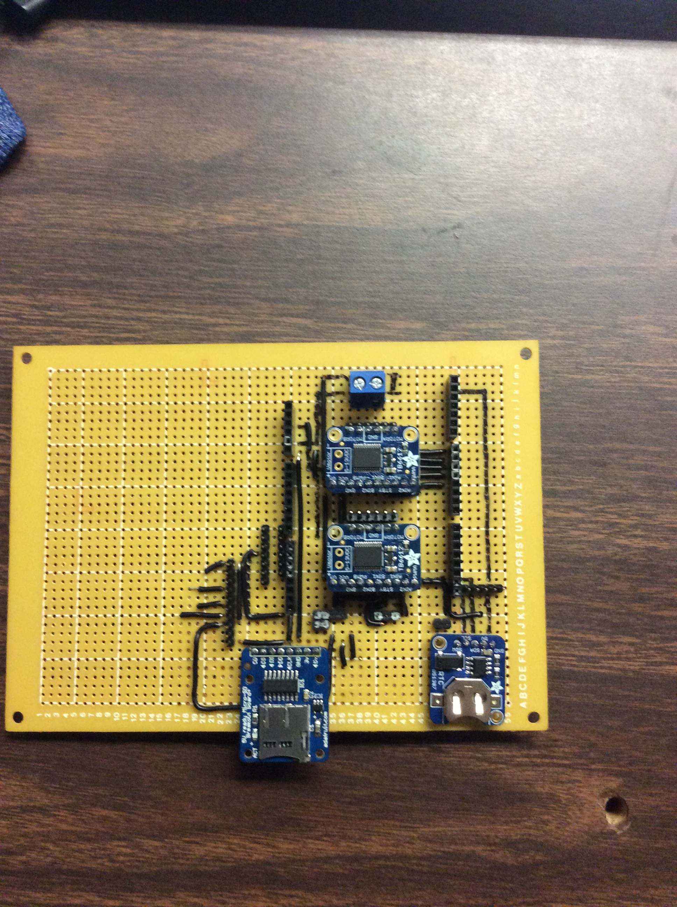
THE HUB
qwe

Slide 3
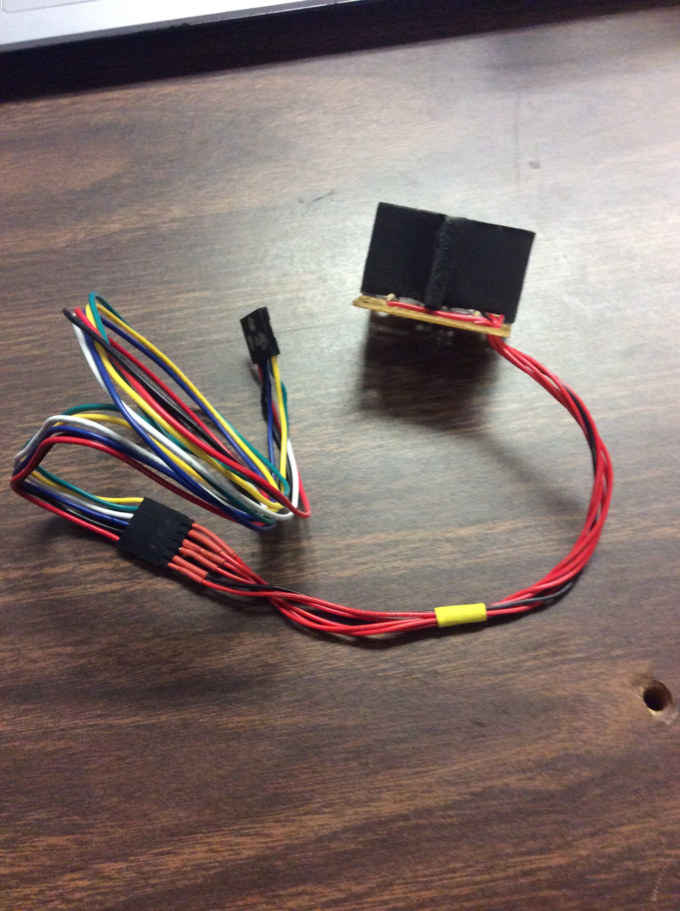
Issues Encountered
qwe

Slide 4
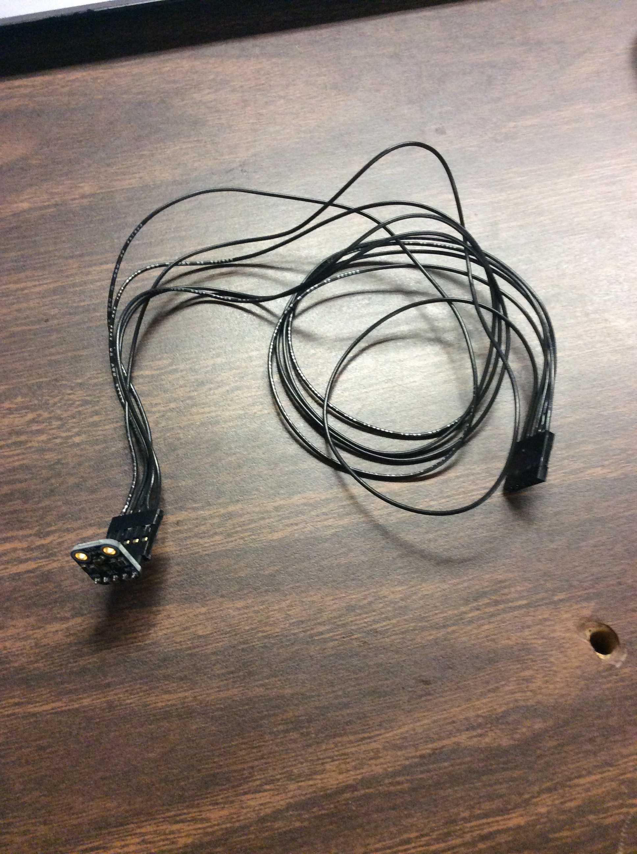
Solutions
qwe

Slide 5

In progress
qwe

Slide 6
qwe

